Slide 1

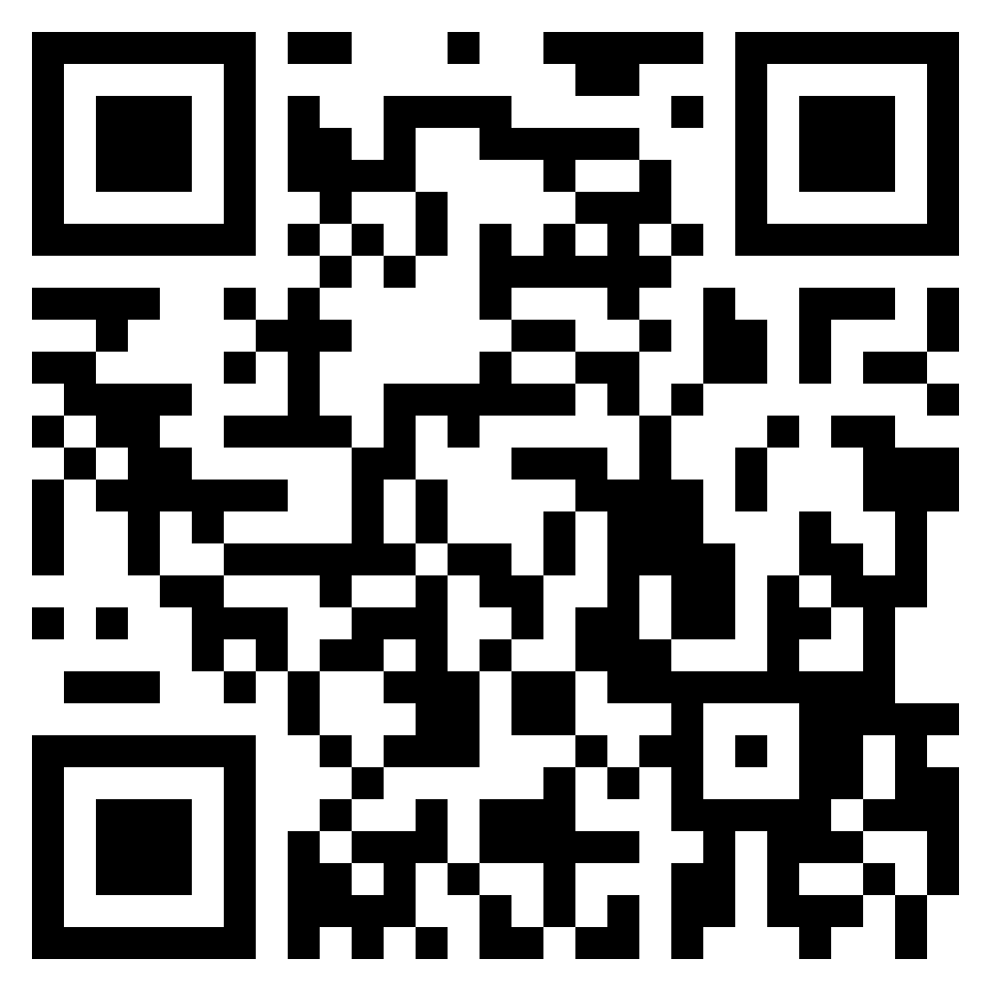
DaBeast Catering LLC
(719) 551-9409
Lunch / Dinner
Cheeseburger ……………………………................................... 13.5
With bacon ……………………….................................. Add 1.5
Smoked Chicken Sandwich …………........................................ 13
Beer Brat ……………………………….......................................... 10
Meal deal: Chips and drink ……………………….…….. Add 3
Pastelillos ………………………………......................................... 5
Stuffed fried empanadas (beef and cheese)
Pincho Fries ................................................................................. 18
Includes smoked chicken, cheese, guava BBQ, and cilantro
Regular Fries ……………..……………........................................... 9
Homestyle Fries …….………………….......................................... 5
Desserts
Fried Oreos ……………….. 5
Fried Cheesecake Bites …. 7
Limber De Coco (Ice Cream)
………………………………. 5
Beverages
Guanabana ……………… 4.5
Creamy tart drink derived from indigenous fruit ☺
Soft Drinks …………………. 3
Gatorade, Red Bull, Coke, Sprite, Fanta, Iced Tea, etc.
Water ……………………….. 3
https://dabeastservices.com

